Slide 1

Heart Failure Data Analysis Mathematics in Machine Learning
A.A 2021/2022
Salvatore Junior Curello s268066

Slide 2
Introduction
This study was focused on survival analysis of heart failure patients who were admitted to Institute of Cardiology and Allied hospital Faisalabad-Pakistan between April and December (2015). The dataset used to perform the analysis is the e "Heart failure clinical records Dataset"
Goal:
The goal of this study is to produce predictions taking into account only the clinical features of the patients and to show which model performs better among all the models that have been tested.

Slide 3
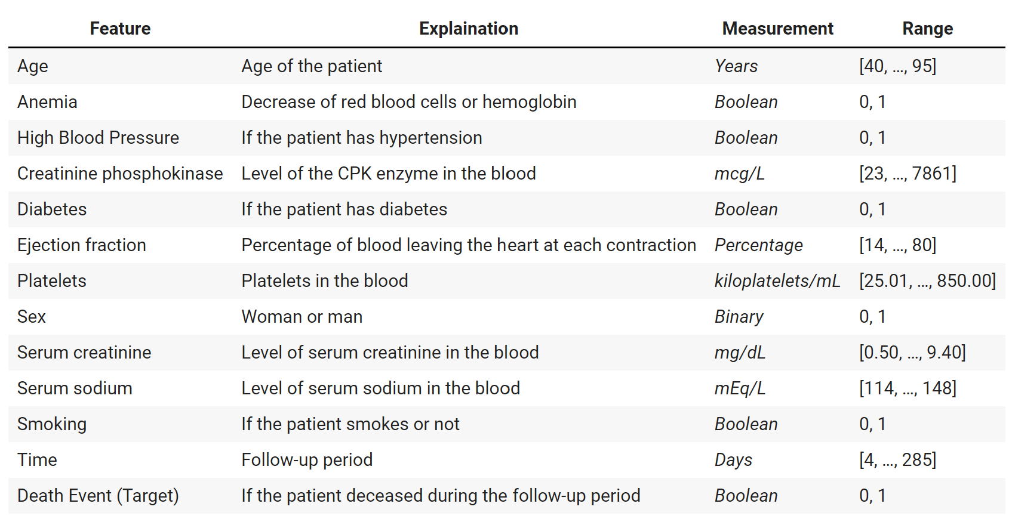
Dataset Overview
It is constitute of 299 patients of heart failure comprising of 105 women and 194 men which their age is in the range [40, ..., 95]. It contains 11 features on which the analysis are based, then the time (which indicates the follow-up period) and the DEATH_EVENT which will be the target variable during the analisys.

Slide 4
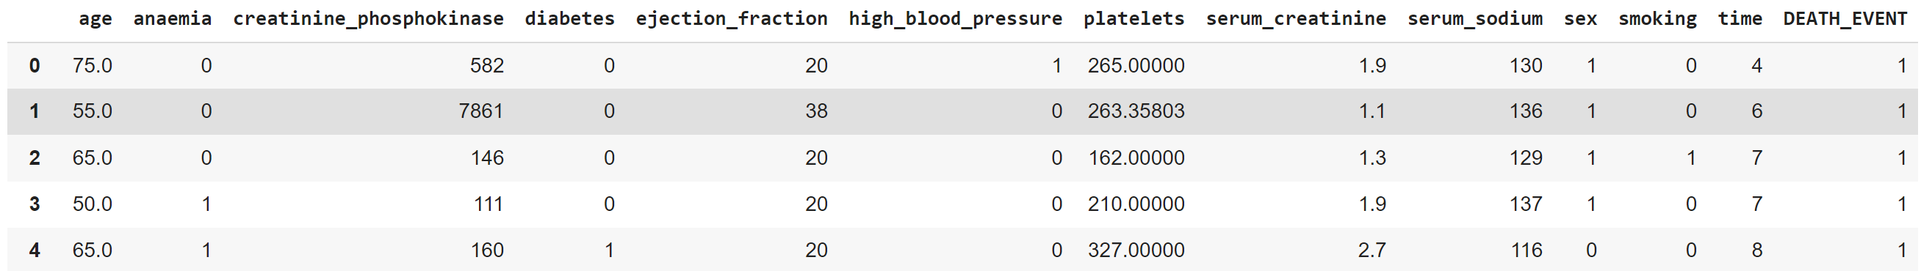
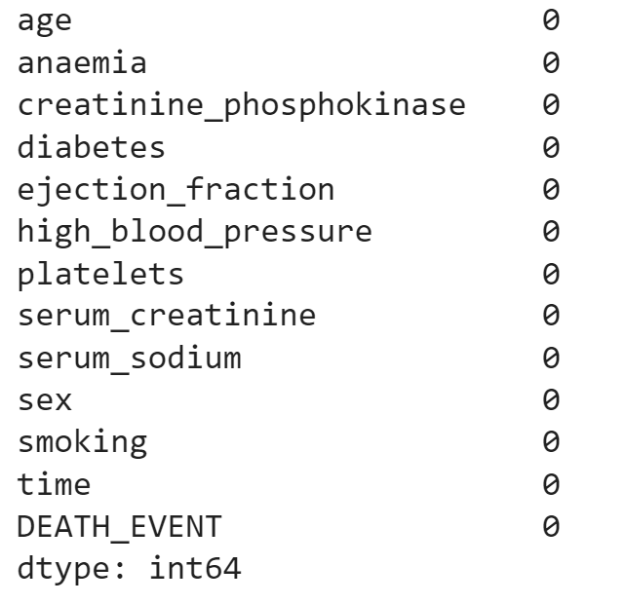
Dataset Visualization & Missing Values
The dataset is constructed as follows:
A null-value check is performed and no missing values were detected:

Slide 5
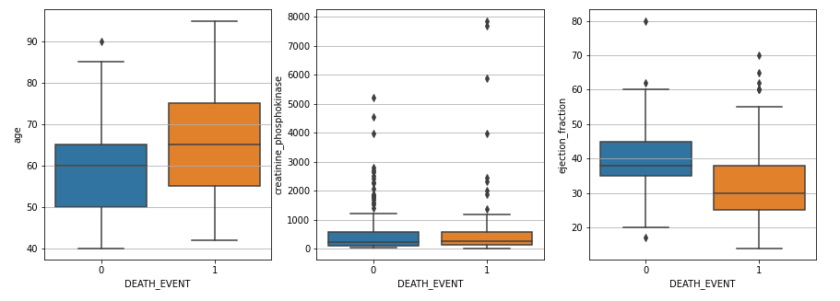
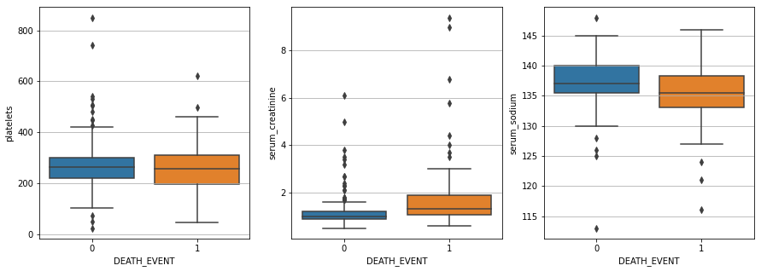
Numerical Features
Numerical Features: age, creatinine_phosphokinase, ejection_fraction, platelets, serum_creatinine, serum_sodium

Slide 6
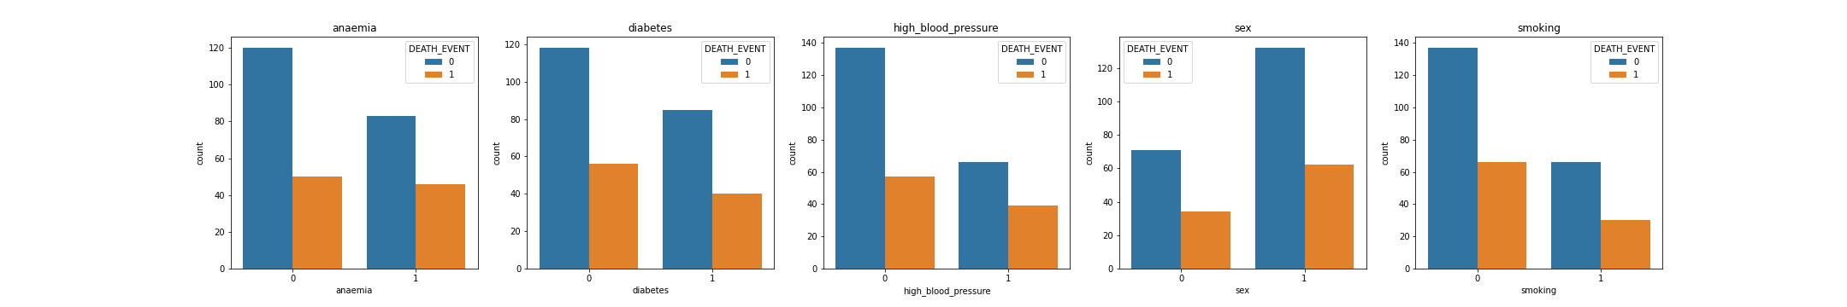
Categorical Features
Categorical Features: anaemia, diabetes, high_blood_pressure, sex and smoking

Slide 7
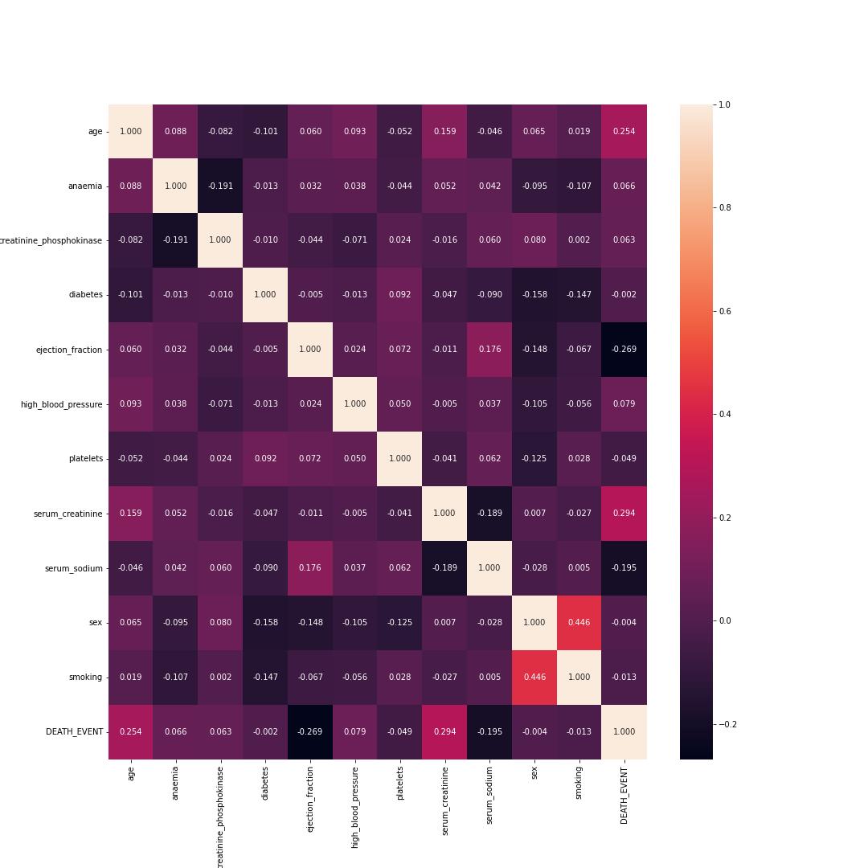
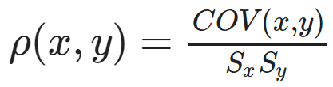
Correlation Matrix
The correlation coefficient of two variables can be computed by dividing the covariance of these variables by the product of the standard deviations of the same values. Mathematically:
The features are quite uncorrelated with the exception of sex and smoking that seems to be slightly positively correlated.

Slide 8
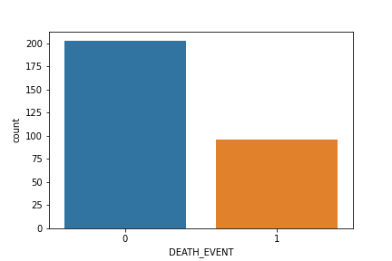
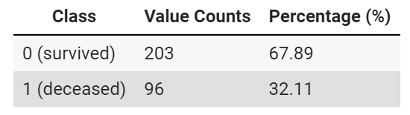
Class Unbalance
In order to avoid biased results it is important to inspect some class imbalance.
Even if not so strong the dataset is slightly imbalanced with 67.89% (203) survival cases & 32.11% (96) death events. In this situation the model could become more inclined towards learning and predicting the negative examples than the positive (death) cases.
To overcome this issue three different technique of re-balancing are applied.

Slide 9
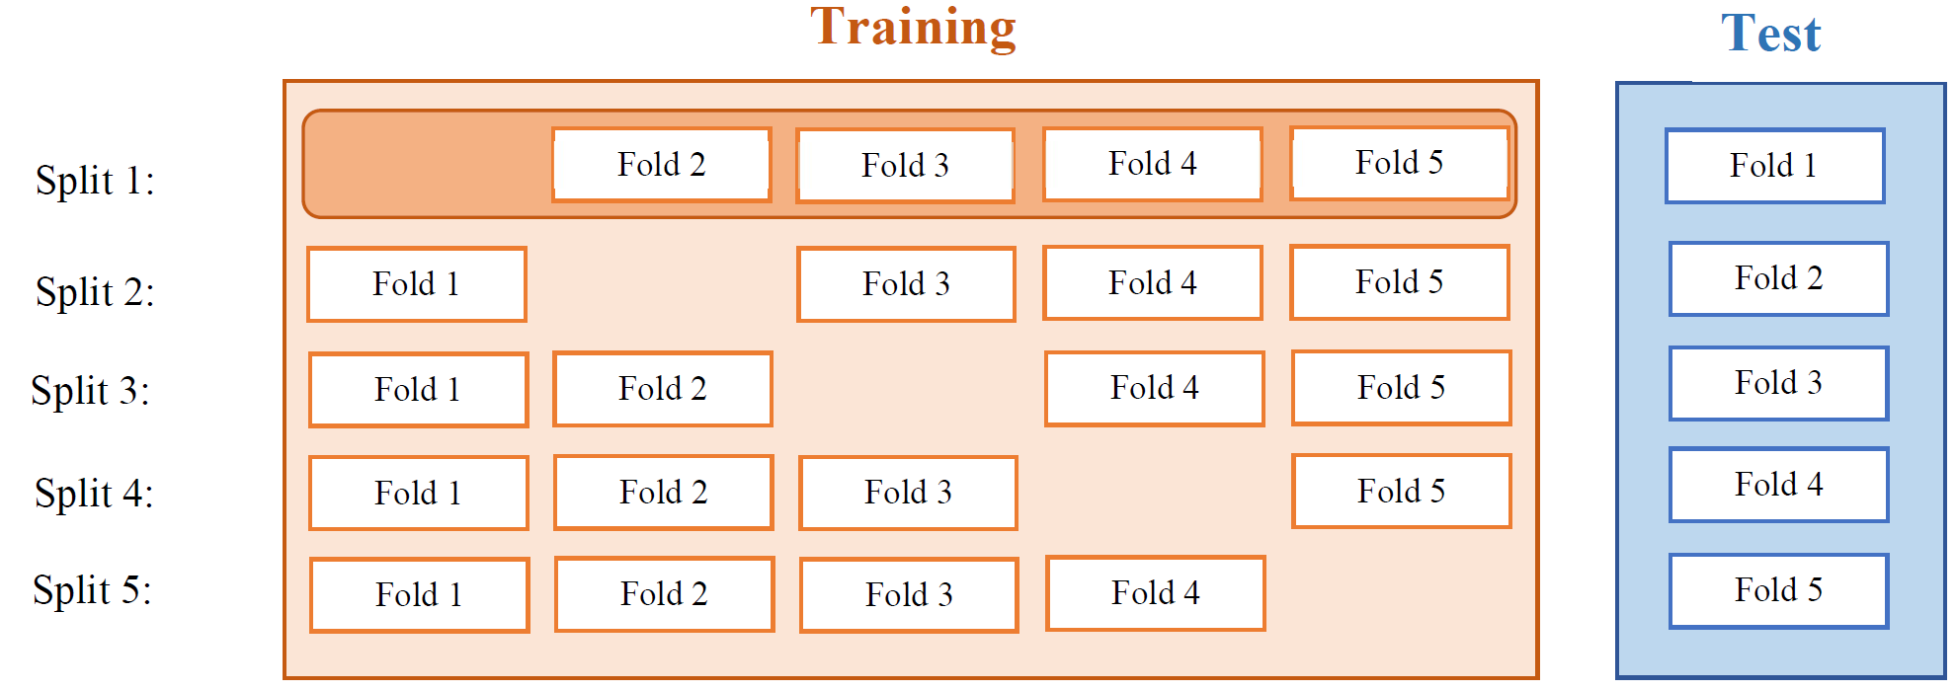
Data Preparation
Holdout: the Holdout method is the most simple validation technique and it consists in splitting the data set in three set: training, validation and testing. The training set is used for training the model, the validation set to evaluate the model in order to find the best parameters and finally the test set is used for testing the model performances on data which was never seen by the algorithm.
K-fold Cross Validation (5-fold): a stratified cross validation is applied with 5 folds.

Slide 10
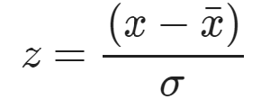
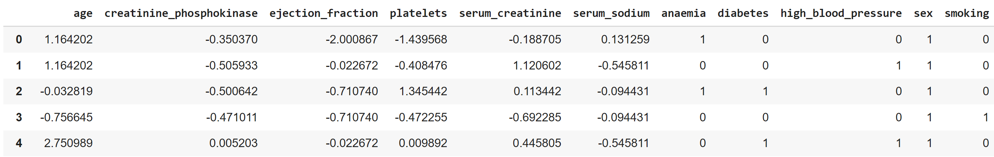
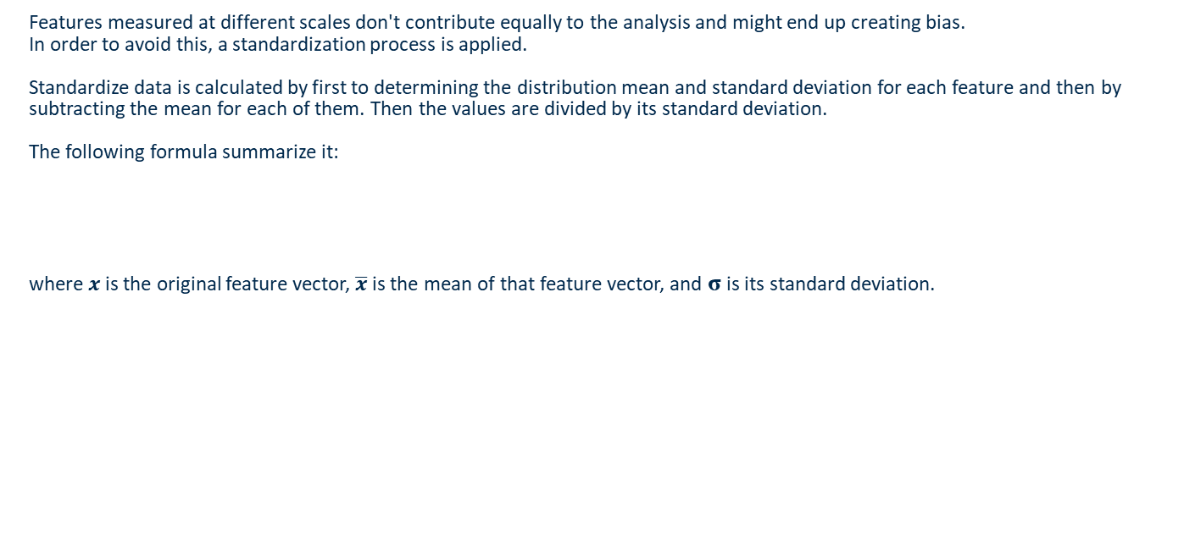
Data standardization
Features measured at different scales don't contribute equally to the analysis and might end up creating bias.
In order to avoid this, a standardization process is applied.
Standardize data is calculated by first to determining the distribution mean and standard deviation for each feature and then by subtracting the mean for each of them. Then the values are divided by its standard deviation.
The following formula summarize it:
where $x$is the original feature vector, $\overline{x}$ is the mean of that feature vector, and σ is its standard deviation.

Slide 11
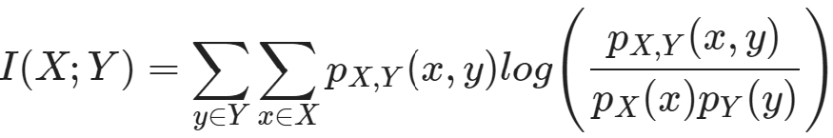
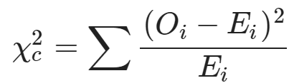
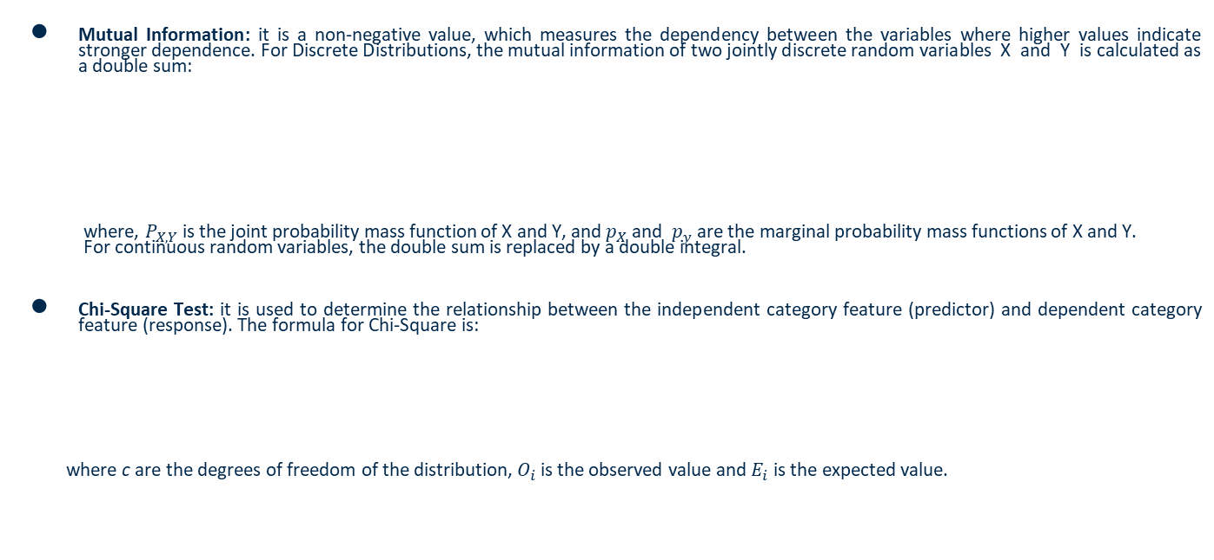
Feature Selection
Mutual Information: it is a non-negative value, which measures the dependency between the variables where higher values indicate stronger dependence. For Discrete Distributions, the mutual information of two jointly discrete random variables X and Y is calculated as a double sum:
where, $P_{X,Y}$ is the joint probability mass function of X and Y, and $p_{X}$ and $p_{y}$ are the marginal probability mass functions of X and Y.
For continuous random variables, the double sum is replaced by a double integral.
Chi-Square Test: it is used to determine the relationship between the independent category feature (predictor) and dependent category feature (response). The formula for Chi-Square is:
where c are the degrees of freedom of the distribution, $O_{i}$ is the observed value and $E_{i}$is the expected value.

Slide 12
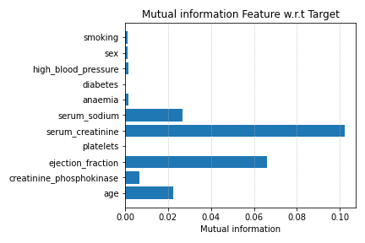
Mutual Information – Holdout
The only continous feauture that could be avoided durign the analisys is "platelets".

Slide 13
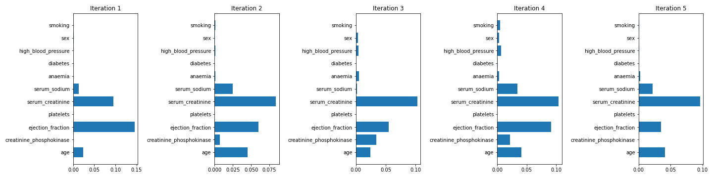
Mutual Information – K-Fold
We have almost the same behevior of the holdout method so we keep all the features except "platelets“.

Slide 14
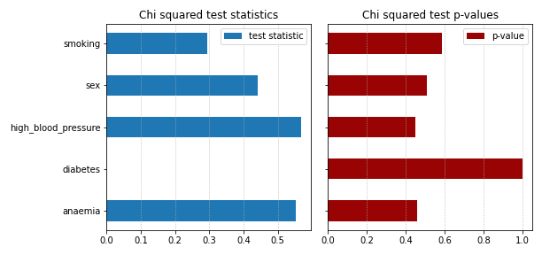
Chi-Squared Test - Holdout
Their contribution is not so high but we still decied to consider the features "high_blood_pressure" and "anaemia"

Slide 15
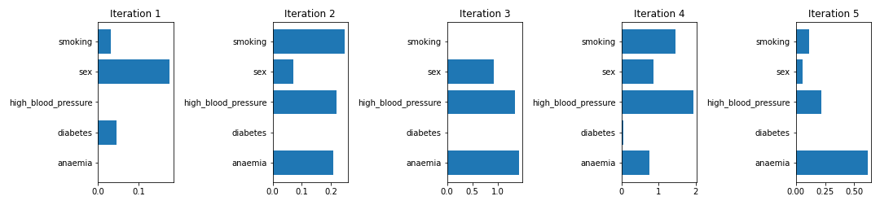
Chi-Squared Test - Kfold
There is a different situation here w.r.t the holdout so only the top 2 features for each iteration are considered.

Slide 16
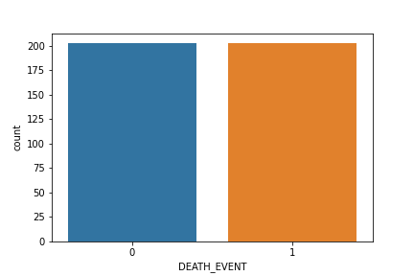
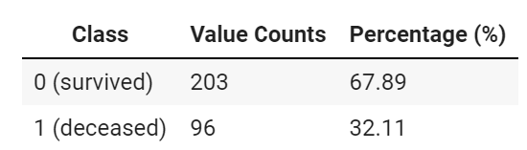
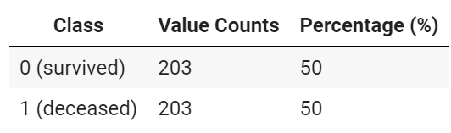
Class Rebalancing – Random Oversampling
Random oversampling is the process of randomly duplicating examples from the minority class and adding them to the training dataset.
BEFORE RANDOM OVERSAMPLING
AFTER RANDOM OVERSAMPLING

Slide 17
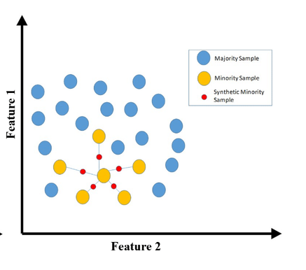


Class Rebalancing – SMOTE
In SMOTE, the training set is altered by adding synthetically generated minority class instances, causing the class distribution to become more balanced. It can be summarized in three steps:
Considering the minority class as $A,$for each $x∈A$, the the k-nearest neighbors of x are obtained by calculating the Euclidean distance between x and every other sample in set $A$.
For each $x∈A$ , N examples (i.e x1, x2, …xn) are randomly selected from its k-nearest neighbors, and they construct the set $A_{1}$.
For each example $x_{k}∈ A_{1}$ (k=1, 2, 3…N), the following formula is used to generate a new example:
$$x^{′}=x+rand\left(0,1\right)∗|x−x_{k}|$$
where rand(0, 1) denotes a random number between 0 and 1.

Slide 18
Class Unbalance – SMOTE-NC
Random oversampling is the process of randomly duplicating examples from the minority class and adding them to the training dataset.

Slide 19
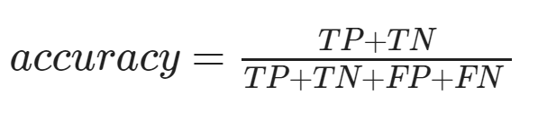
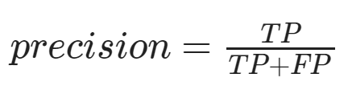


Model Selection - Metrics
Each model will be evaluated according different metrics.
Accuracy: It is defined as the number of correct predictions divided by the total number of predictions
Precision: It is defined as the number of true predicted positives over the total number of positives(is the fraction of relevant instances among the retrieved instances)
Recall: It is defined as the number of true predicted positives over the total number of positives(is the fraction of relevant instances that were retrieved)
F1 score: It is the harmonic mean between precision and recall. Its range is [0,1] and its value indicates how precise and robust the classifier is.

Slide 20
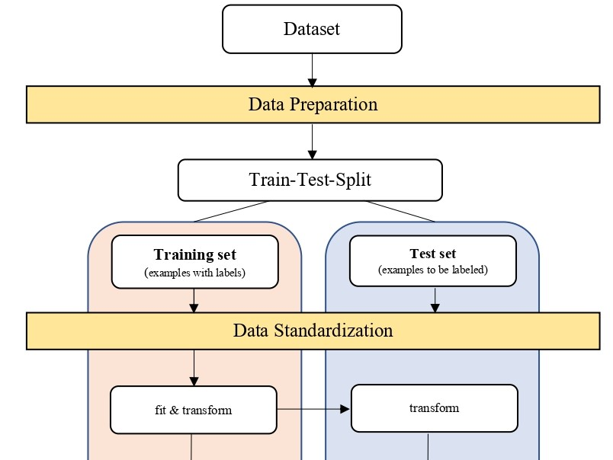
Pipeline HOLDOUT (1)

Slide 21
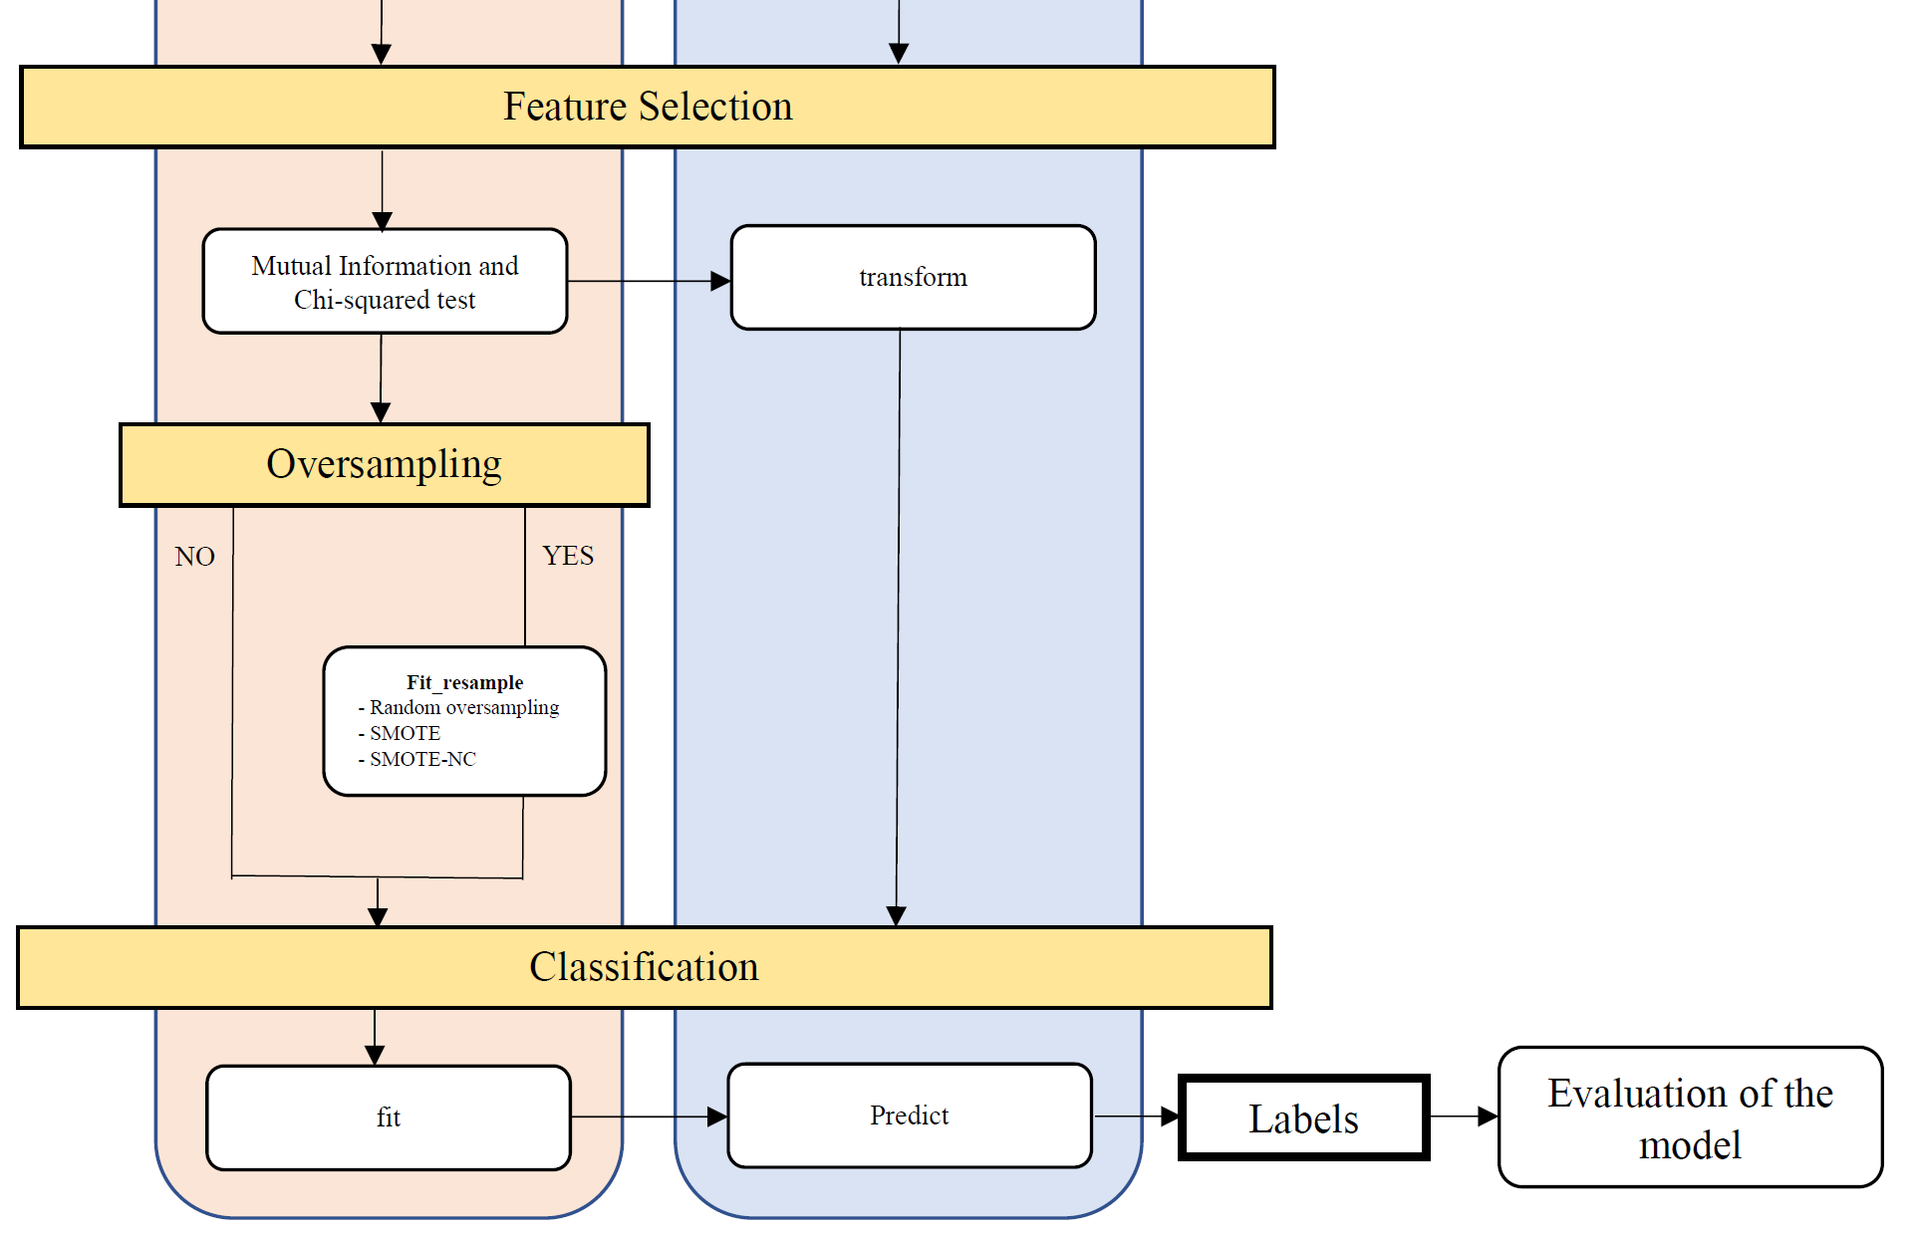
Pipeline HOLDOUT (2)

Slide 22
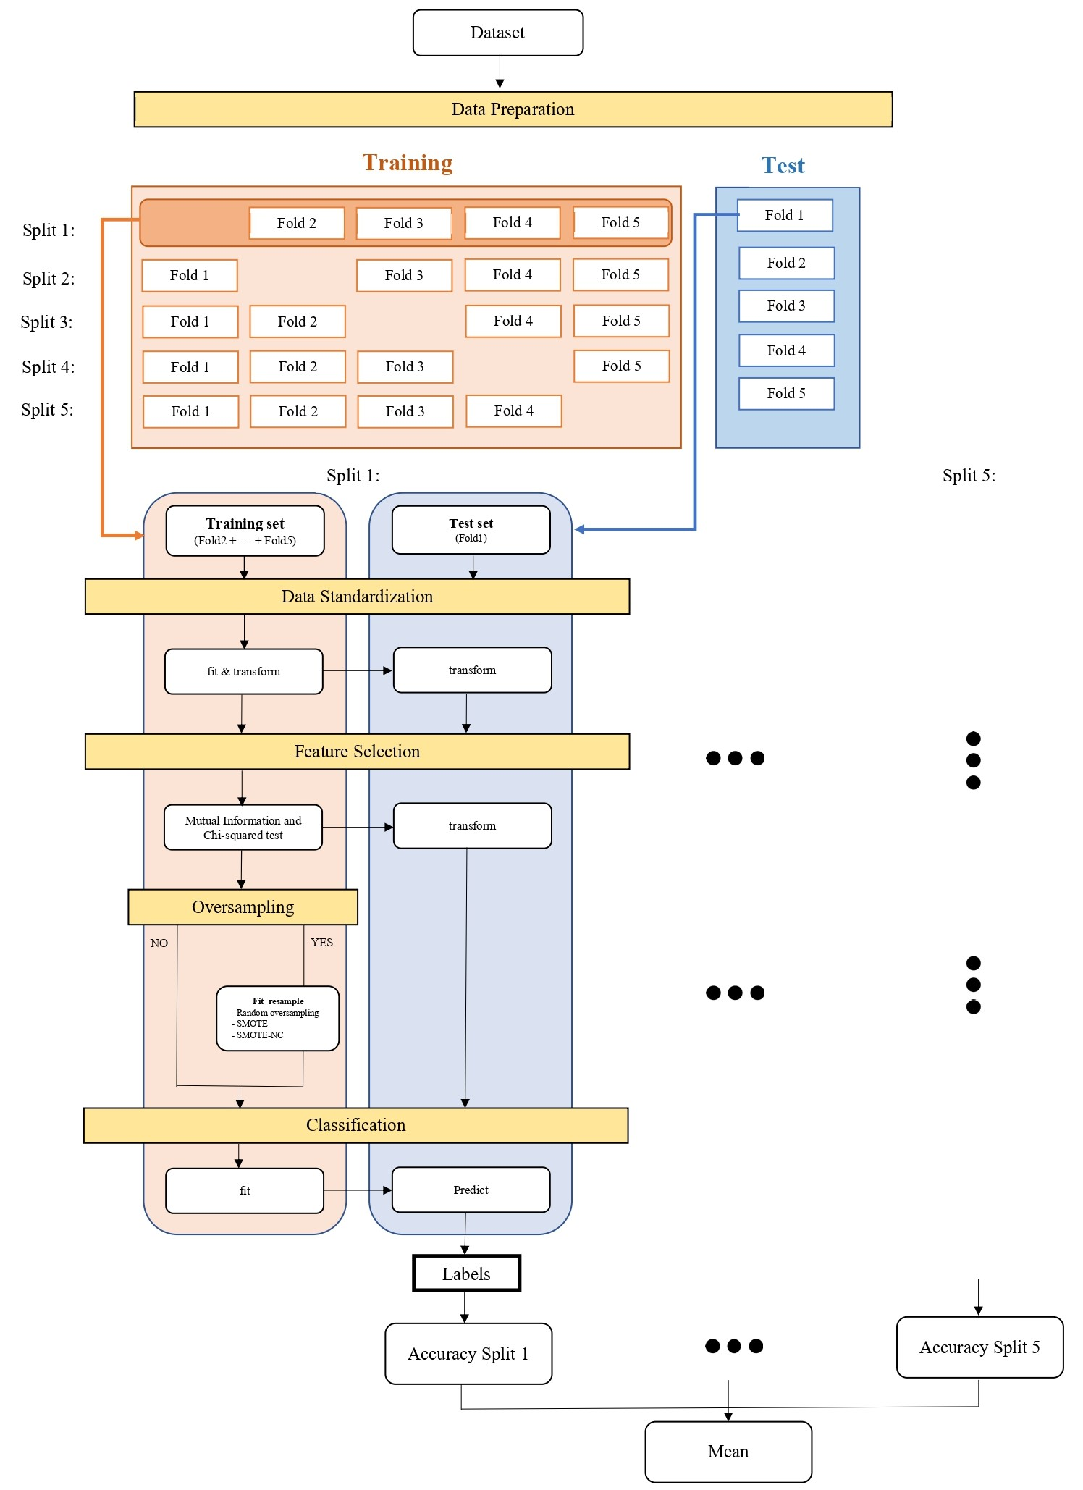

Pipeline K-FOLD (1)

Slide 23
Pipeline K-FOLD (2)

Slide 24
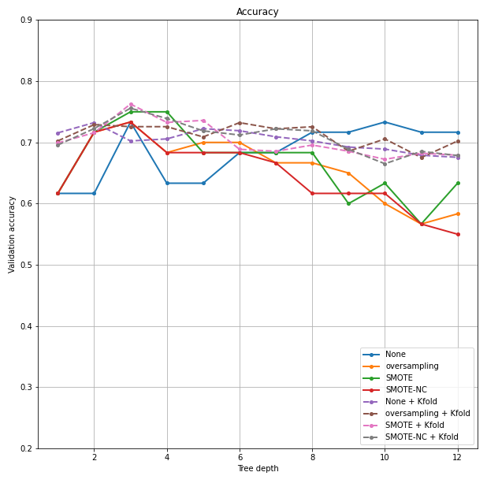

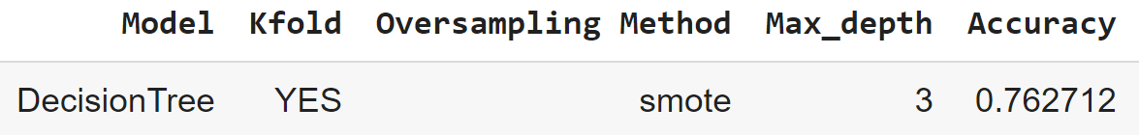

Decision Tree
Decision Trees are a supervised learning method used for classification and regression. The goal is to create a model that predicts the value of a target variable by learning simple decision rules inferred from the data features. Basically, a process of dividing up the input space is applied. A greedy approach is used to divide the space called recursive binary splitting.
The measure that we used to do so is the Gini Index which can be formalized as follow:
where $p_{k}$ is the ratio between number of samples of class $k$ and total number of samples(the proportion of training instances with class k).
Hyperparameters: max_depth=[1,2,3,4,5,6,7,8,9,10,11,12]
Best configuration:

Slide 25

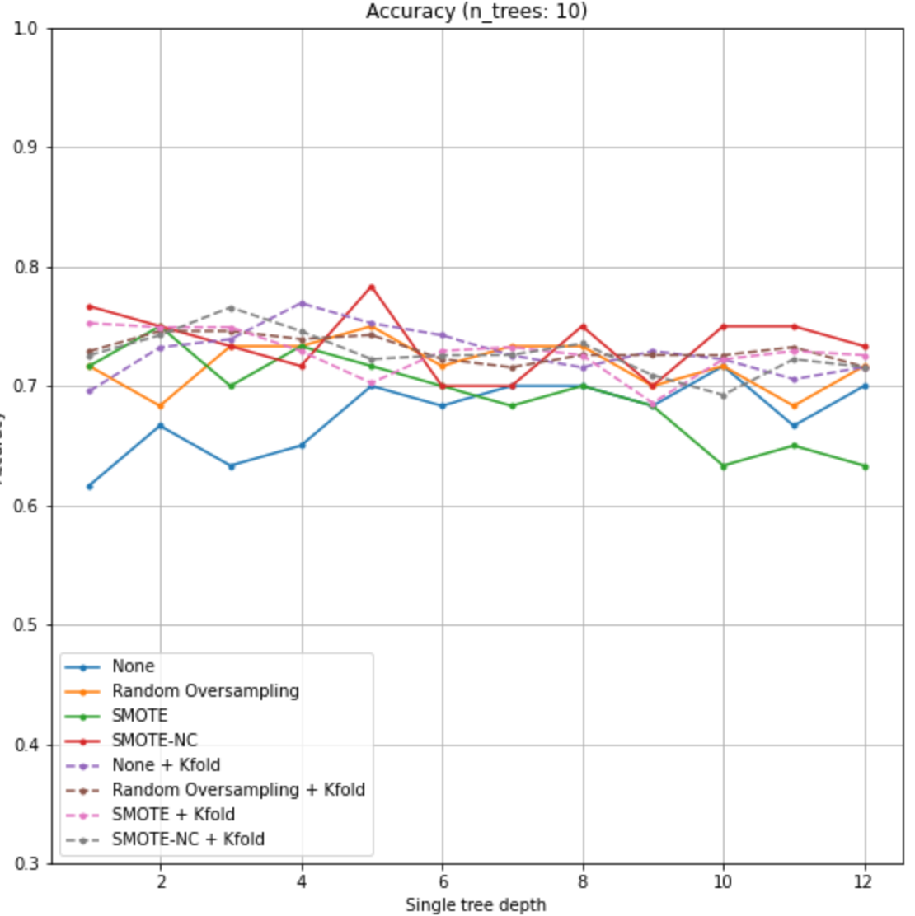
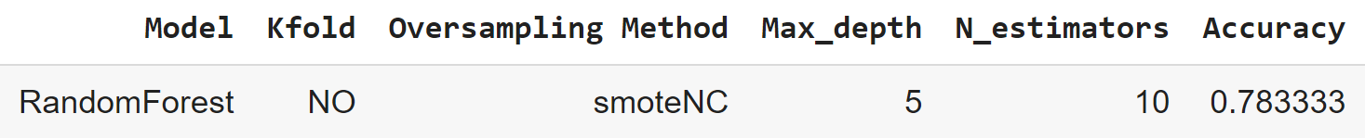

Random Forest
Random Forest is an esemble of decision trees. Basically, we build a number of decision trees on bootstrapped training sample. But when building these decisione trees, each time a split in a tree is performed, a random sample of m predictors is chosen as split candidates from the full set of p predictors. The split is allowed to use only one of those m predictors. Typically, we choose $m≈\sqrt{p}$.
Hyperparameters:
max_depth=[1,2,3,4,5,6,7,8,9,10,11,12]
n_estimators = [5,10,20,50,100]
Best configuration:

Slide 26
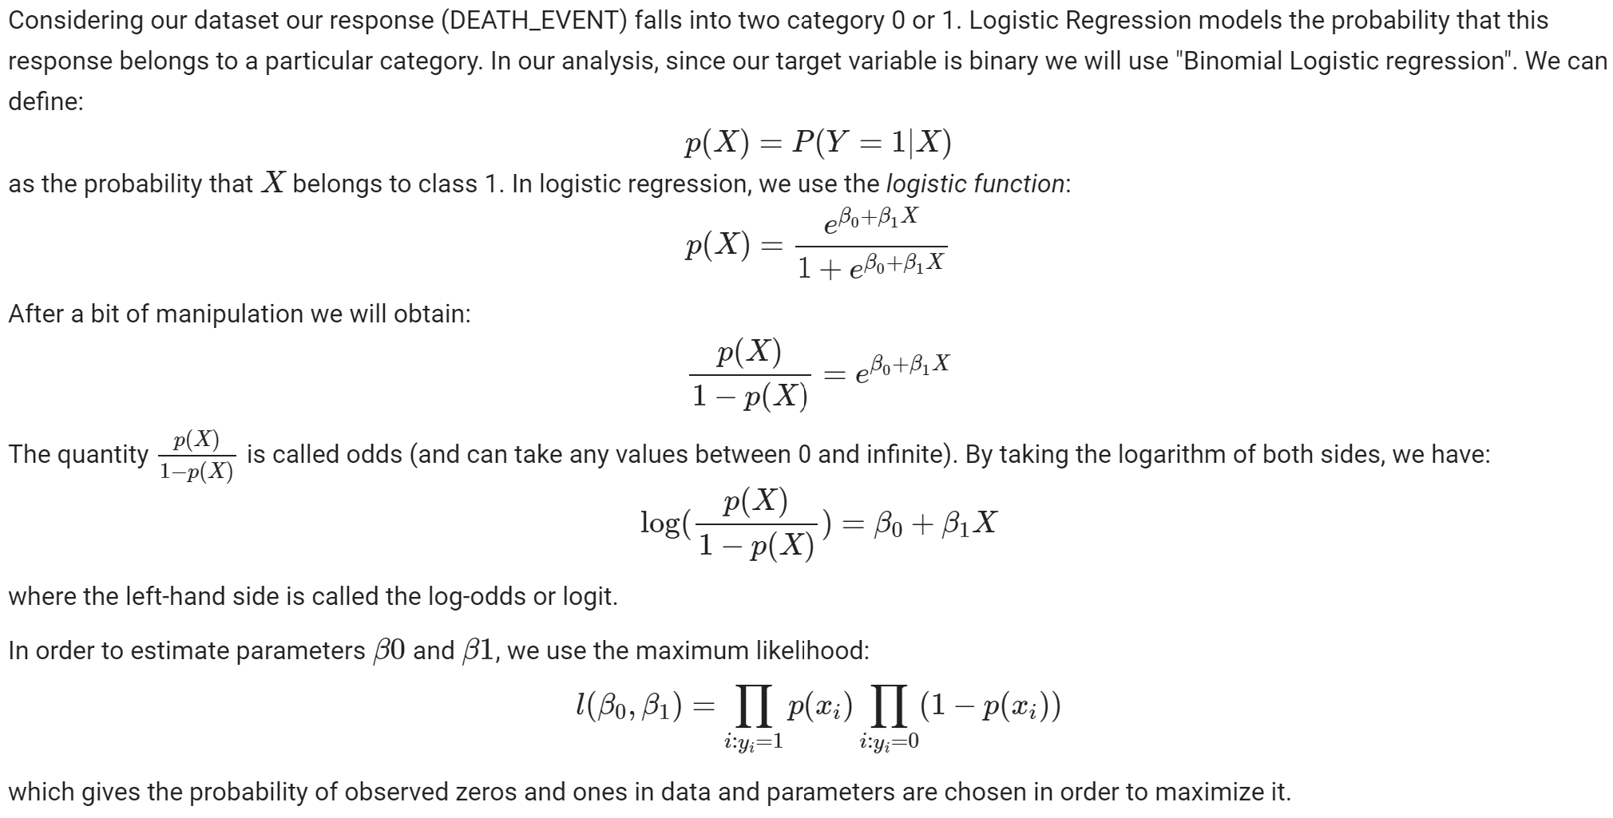
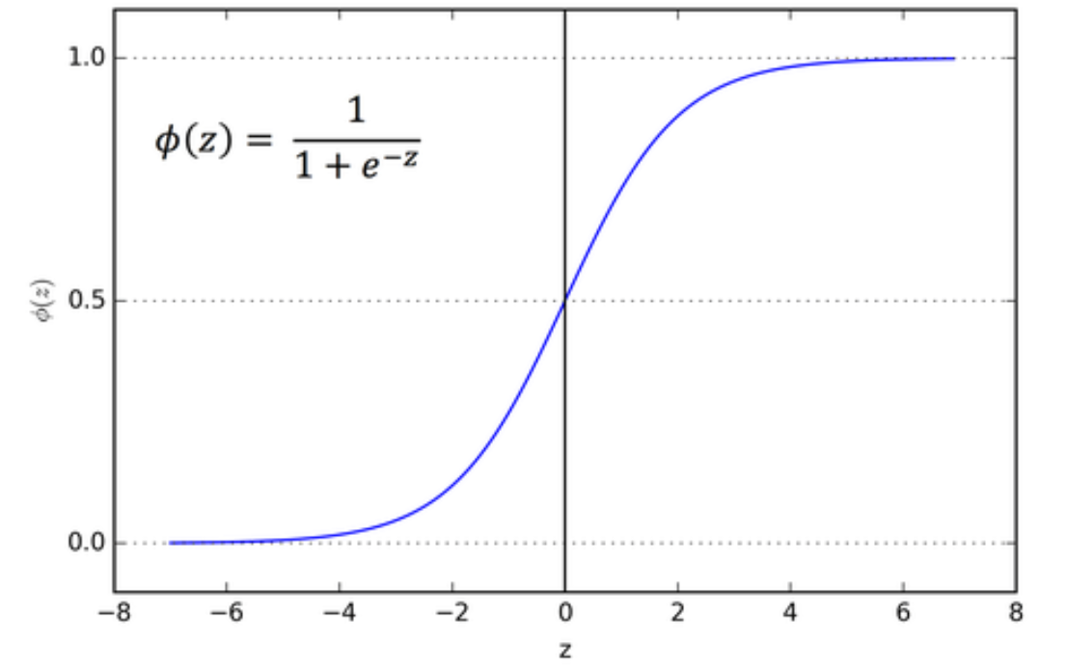
Logistic Regression (1)

Slide 27
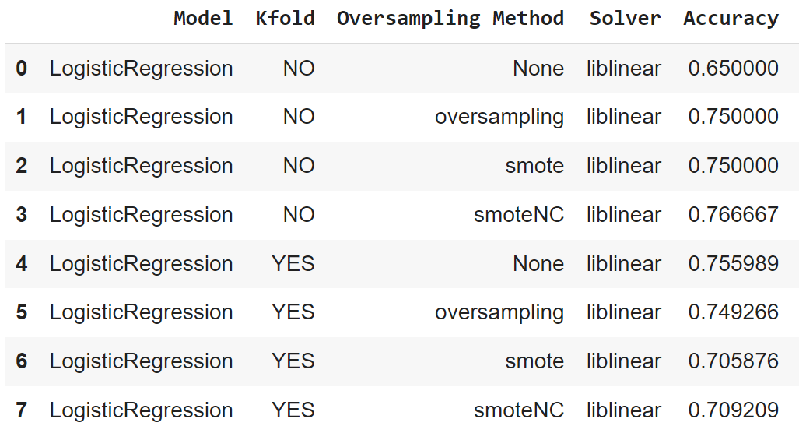
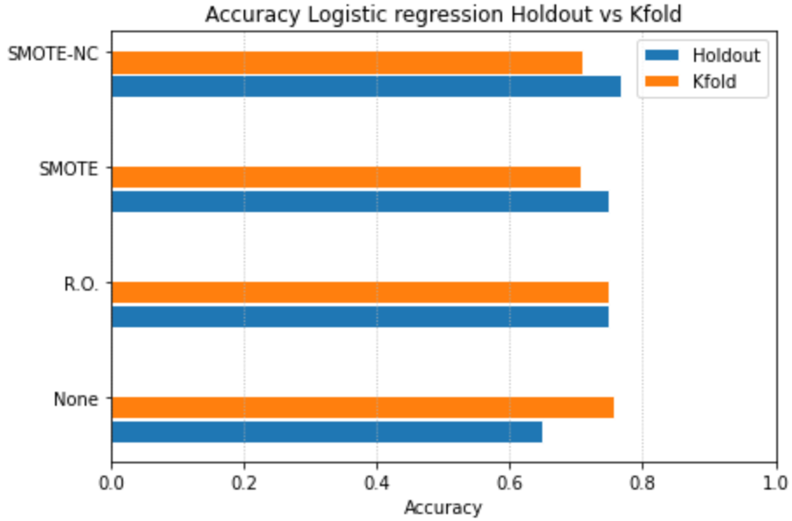
Logistic Regression (2)
Best configuration:
C=1

Slide 28
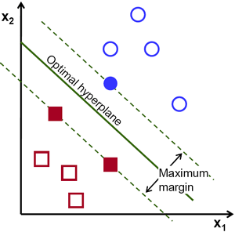
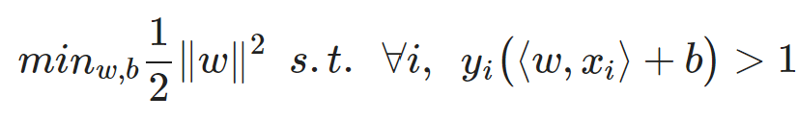

Support Vector Machine (1)
It consists of finding a Hyperplane that separates the training set with the largest possible margin (meaning the smallest distance between the hyerplane and a training sample).
Hard-SVM
Soft-SVM
Kernel Trick

Slide 29
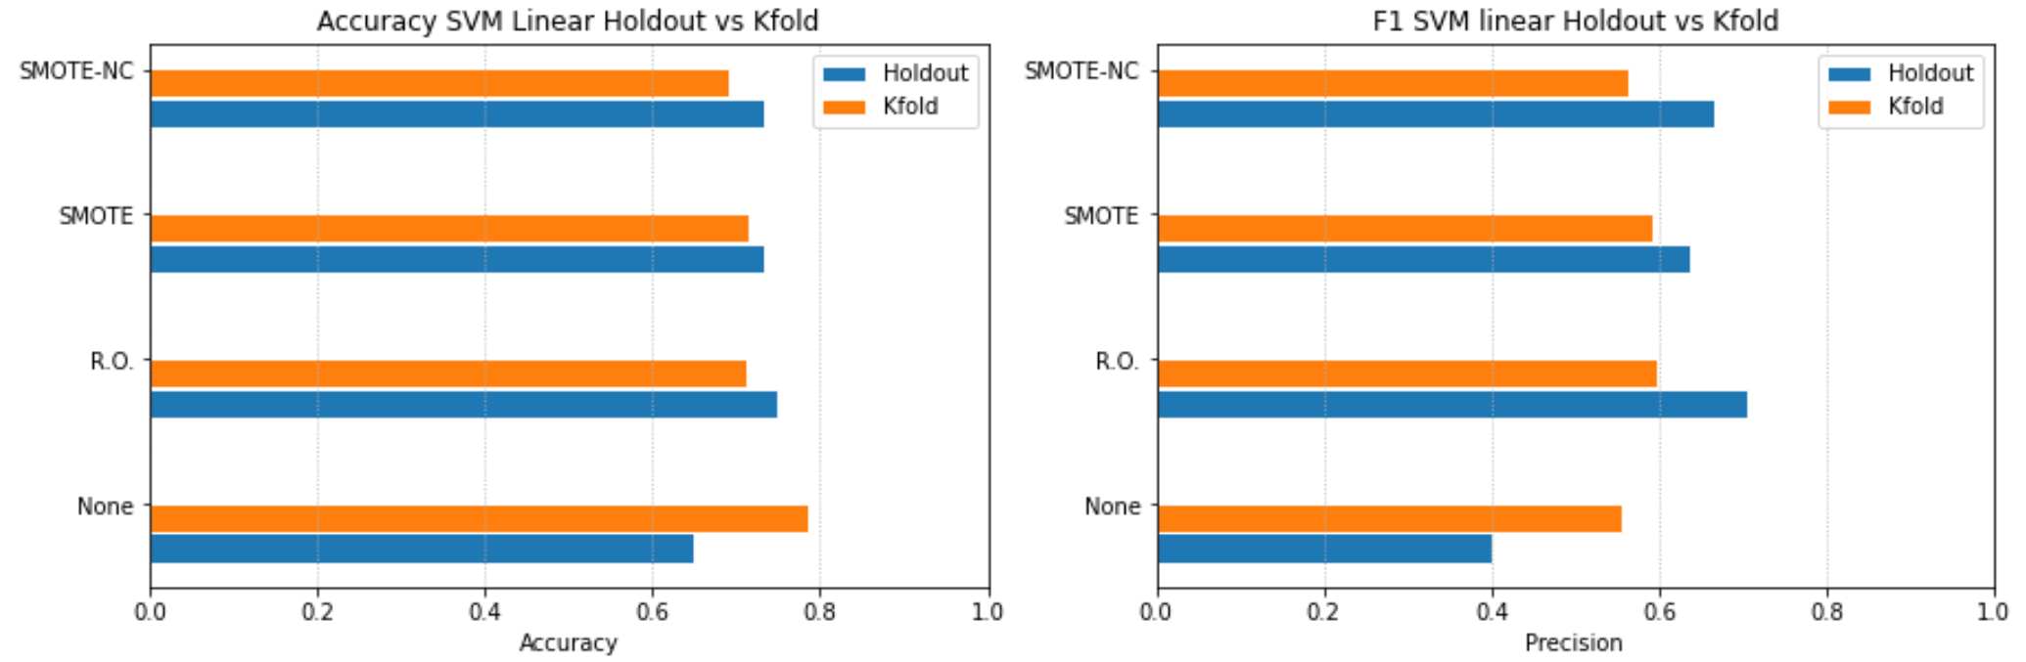
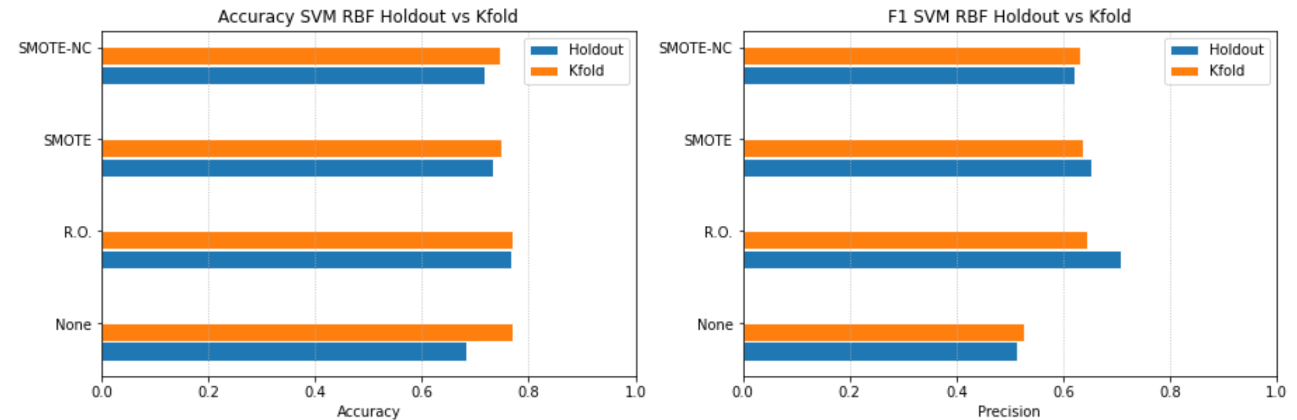

Support Vector Machine (2)
Hyperparameters (Linear SVM): C=[0.01,0.1,1,10]
Best Configuration: C=1
Linear SVM
RBF

Slide 30
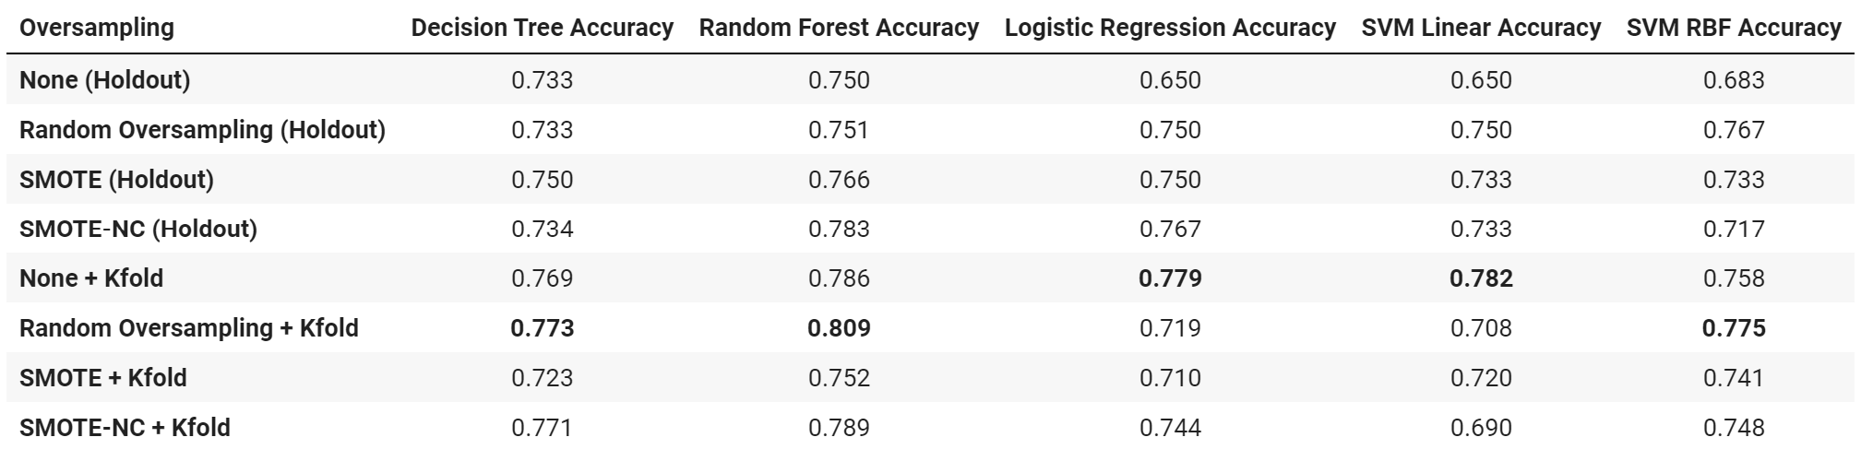
Results (1)
Accuracy

Slide 31
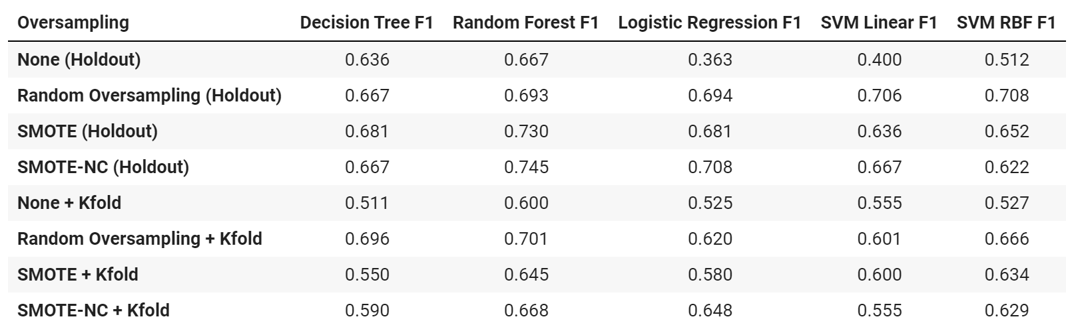
Results (2)
F1

Slide 32
Thank you for your attention

